Slide 1
Customer Retention Case Study Presentation
John Tojo
Data Science Intern

Slide 2
Overview
Introduction
Problem Statement
Exploratory Data Analysis (EDA)
Visualization
Observations
Inference
Future Work

Slide 3
Introduction
What is Customer Retention ?
"The capacity of a corporation to turn consumers into repeat buyers and keep them from moving to a rival is referred to as customer retention."
Why Customer Retention plays a vital role?
With the rapid global growth in electronic commerce (e-commerce), it is important to gain a competitive advantage by retaining the customers, customers retention dependents on various factors, which is analysed based on the data obtained and why the customers prefer to shop in certain retail stores compared to others

Slide 4
Advantages of customers retention
Customers who have shopped in particular firm will promote their family members or friends to shop from that particular firm
Customers feel a sense of financial security, as they feel they can save some amount by shopping in that firm
Chance for dropping an item from purchasing is reduced drastically as the customers might feel as it as the right price
It is easy to maintain customers than trying to generate new customers
Customer Retention Strategies
Understanding the needs of the customers
Collect feedbacks and analyze where improvements are needed and implement it
Loyalty programs and gaining trust from customers

Slide 5
Problem Statement
Customers retention plays a vital role in determining the success or failure of online retail store
The study needs to find what are the factors that help in retaining the customers
The study then analyses few online retail stores and, infer the customers behavioral pattern and infer the requirements and needs, that helps to grow an insight as to why the customers prefer that particular store compared to others
Based on the above observation improvements can be adopted that help in improving the customer retention

Slide 6
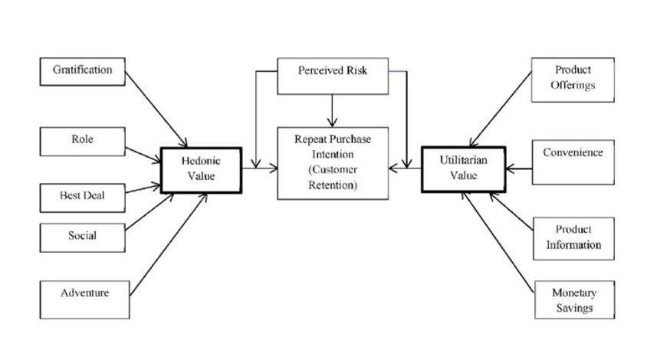
The problem statement represented in diagram
Utilitarian value: Utilitarian value is an objective value which provides some functional benefits to the consumers and helps consumers to accomplish practical tasks.
Hedonistic value: Hedonistic value is subjective (Psychological) value which provides an experiential satisfaction. In other words, the immediate psychological gratification that comes from experiencing some activity or from consumption of a product

Slide 7
Exploratory Data Analysis (EDA)
269 rows
71 columns
Changed column name
No null values present.
66% duplicate fields/records found
Didn’t drop any as data loss would be huge
Except pin code all are object data type

Slide 8
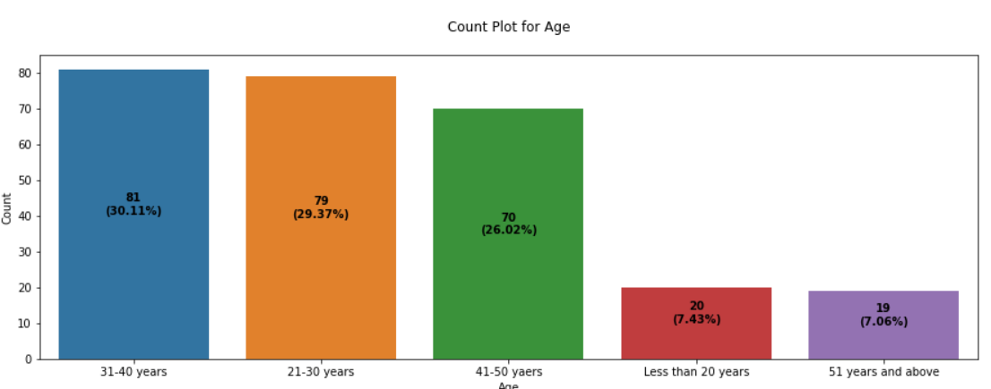
Visualization
Understanding the people who took part in the survey

Slide 9
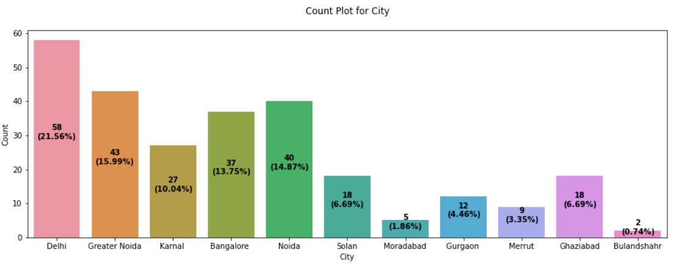
Cities from where data was gathered

Slide 10
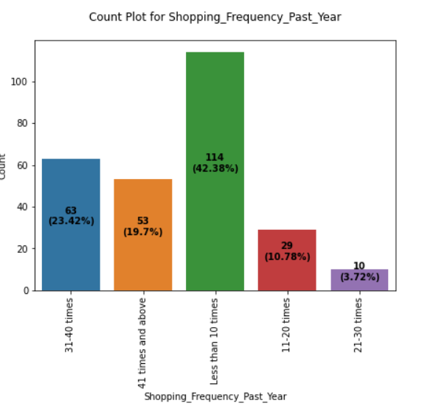
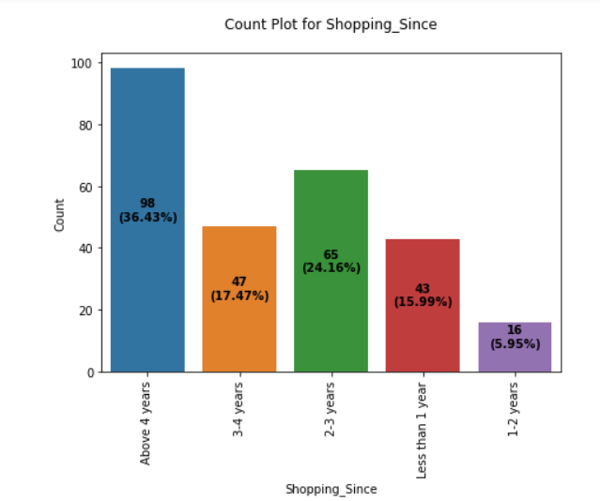
Understanding how customers reacted to online platform and frequency of usage

Slide 11
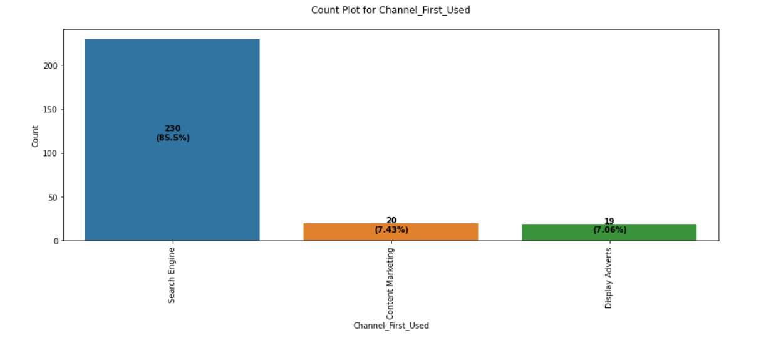
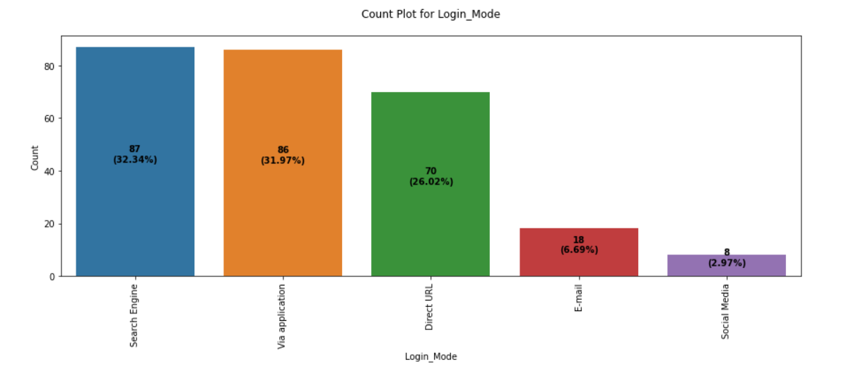
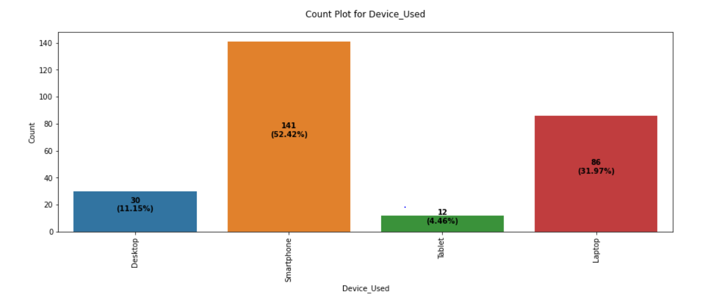
Understanding how customers accessed

Slide 12
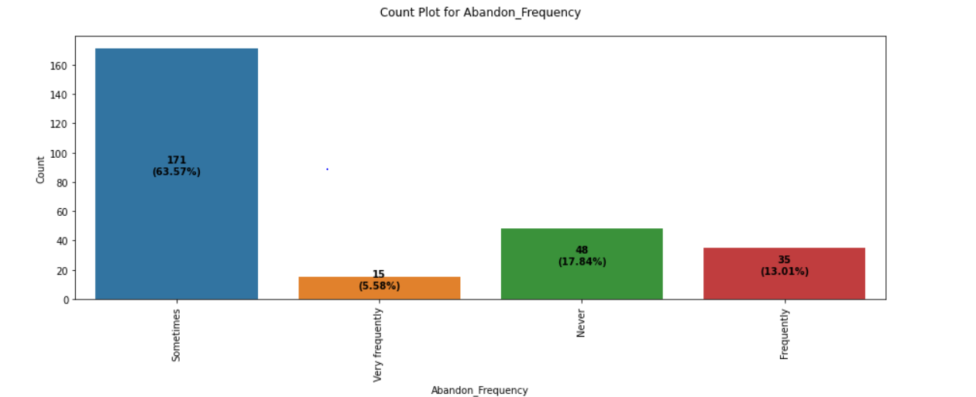
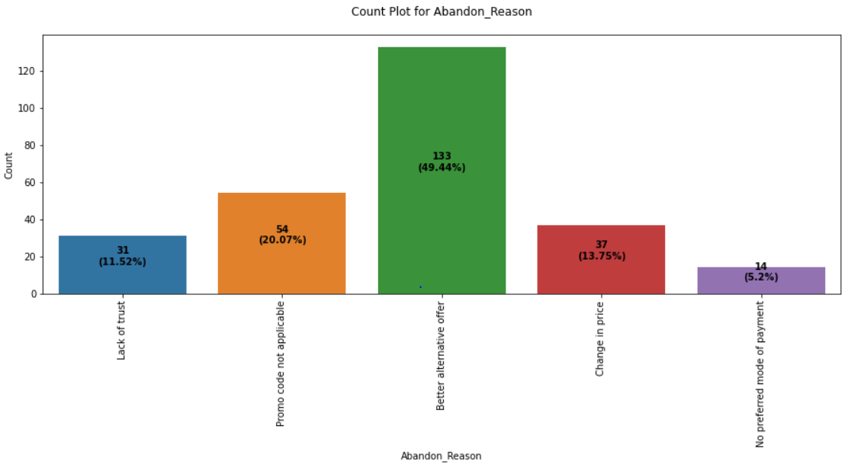
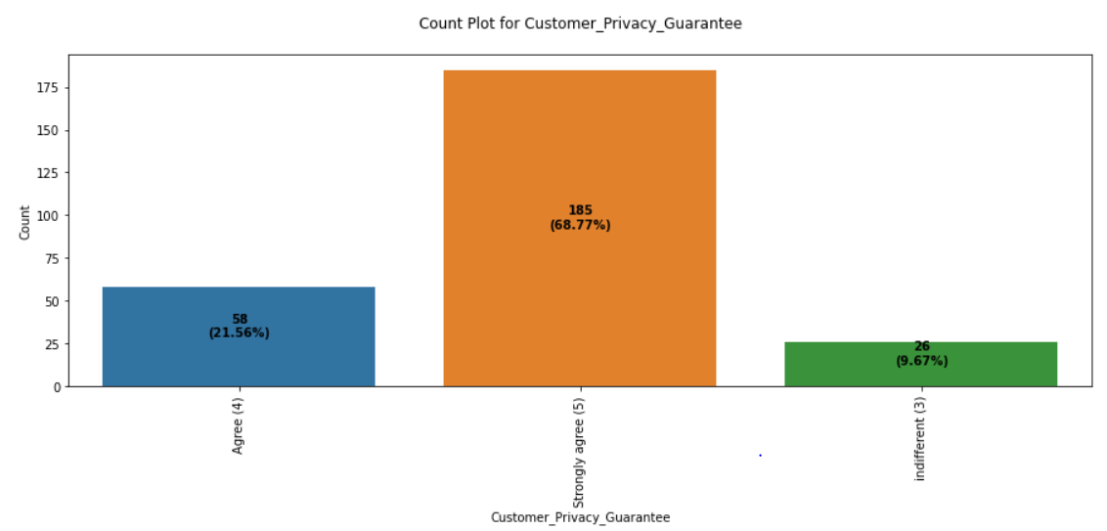
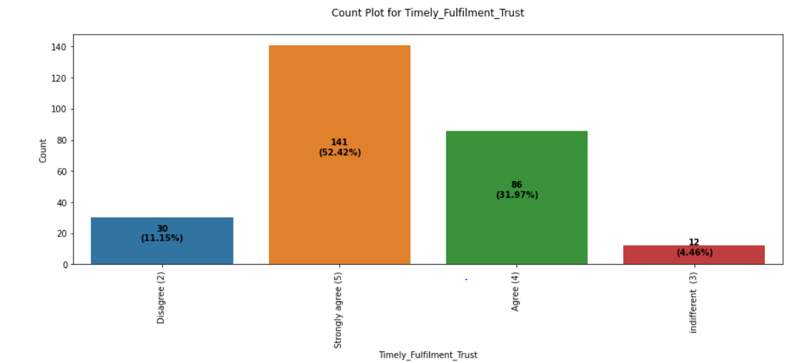
Understanding behavior of customers

Slide 13
Observations from analyzing Amazon
Amazon 1. Improvements needed a) amazon struggles during offer period, customers face difficulty to login and for web page to load during offers this is mainly because of high traffic which occurs because it has large no. of customers compared to other service providers solution can be by increasing bandwidth or by further optimising the website b) amazon should try to announce price for producrs during offers as early as possible this can further help the customers who shop in other websites to be slowly included, but there is another risk which should be taken into account that would be rival companies could try to sell the same product at more cheaper price so study should be done on when the price declaration should be done during offers 2. Amazon is preferred by most of the people and has one sided dominance when compare with others

Slide 14
Observations from analyzing Flipkart
Flipkart 1. improvements needed a) struggles during offer period, customers face difficulty to login and for web page to load during offers this is mainly because of high traffic which occurs because it has large no. of customers compared to other service providers solution can be by increasing bandwidth or by further optimising the website b) should provide no. of options for payment 2. Amazon is preferred by most of the people and has one sided dominance when compare with others

Slide 15
Observations from analyzing Myntra
Myntra 1. Improvements needed it has problems with reliability with the website it doesnt have quick purchase option or needs to make changes so customers can buy the product by entering the details as less as possible it doesnt deliver product very fast so needs to work on logistics and provide training to personal and automate some process to deliver the products within the delivery day and avoid late delivery customers dont trust mytra so i needs to work on how to get the trust from customers needs to provide multichannel assistance, because it can be frustrating when customers dont get their queries resolved within the stipulated time needs to declare prices during offers as early as possible to attract customers needs to work on their website to increase efficiency and decrease loading time this is mainly because of high traffic which occurs because it has large no. of customers compared to other service providers solution can be by increasing bandwidth or by further optimising the website 2. During offers compared to others its easier to login and website load faster

Slide 16
Observations from analyzing Snapdeal
Snapdeal 1. Improvements needed needs to work on introducing a wide variety of products and provide all the relevant info regarding the product website needs to efficient, less loading time, needs to be more reliable needs to provide quick purchase options where customers have to enter the least amount of details to purchase an item needs to provide wide variety of payment options needs to work on customer privacy it doesnt deliver product very fast so needs to work on logistics and provide training to personal and automate some process to deliver the products within the delivery day and avoid late delivery needs to provide multichannel assistance, because it can be frustrating when customers dont get their queries resolved within the stipulated time 2. During offers compared to others its easier to login and website load faster

Slide 17
Observations from analyzing Paytm
Paytm 1. Improvements needed needs to work on introducing a wide variety of products and provide all the relevant info regarding the product website needs to efficient, less loading time, needs to be more reliable, reduce the loading time needs to provide wide variety of payment options needs to offer a sense of financial security needs to provide multichannel assistance, because it can be frustrating when customers dont get their queries resolved within the stipulated time

Slide 18
Inference
The first 47 aspects, based on general observations, give insights into how e-retail is beneficial and increasing based on consumer feedback. The data revealed which CITY, PIN CODE, AGE, and other variables were utilized most frequently on the web platform. It also revealed that some criteria are given less weight in contributing to the success of an e-commerce site, allowing us to eliminate such aspects while keeping all the vital ones. We might also improve on some of the elements that impact the likelihood of repeat purchases by internet clients.
Apart from the first 47 elements, the remaining features demonstrated which web platform was utilized more frequently depending on success factors. According to the customer activation and retention case study, Amazon is the most dependable and has met all of the consumer needs. Following Amazon, research indicated that Flipkart was utilized more for online shopping.
According to a case study of Indian e-commerce clients, Amazon and Flipkart are the most frequently utilized for online shopping and are the most frequently suggested by friends. So, based on the research considerations, Amazon and Flipkart are e-commerce platforms that combine utilitarian and hedonistic values to favorably influence recurrent purchase intent (loyalty).

Slide 19
Conclusion
able to understand the customer behaviour to online shopping is positive as it is clear that the no of customers are slowly increasing
amazon is the most preferred online retailer followed by flipkart
consumers purchasing decisions were dependent on various factors
most of the customers doesn't prefer online shopping this could be considering the fact of privacy and online transactions which makes the customers nervous

Slide 20
Future Work
Need to scale data’s, skewness check is not needed as all data's are categorical data's
Unsupervised machine learning models can be used for clustering the customers according to their behaviours, which can later be used to target the customers and giving them some privileges, so they gain a sentimental attachment to the company

Slide 21


